Slide 1
¹⁵N NMR relaxation data as structural restraints
for
assembling protein complexes
and structure determination of globular proteins
Yaroslav Ryabov

Slide 2
OUTLINE
NMR relaxation data and different types of protein motions
Modeling of protein diffusion tensor
Docking protein–protein complexes using NMR relaxation data
components of diffusion tensor or ratio of relaxation rates
Uncertainties and Errors in experimental data
Structure determination of globular proteins
Using NMR relaxation data in Xplor-NIH

Slide 3
Experimental observables and protein motions
Longitudinal relaxation rate
Spectral density
Orientation
correlation function
Transverse relaxation rate

Slide 4
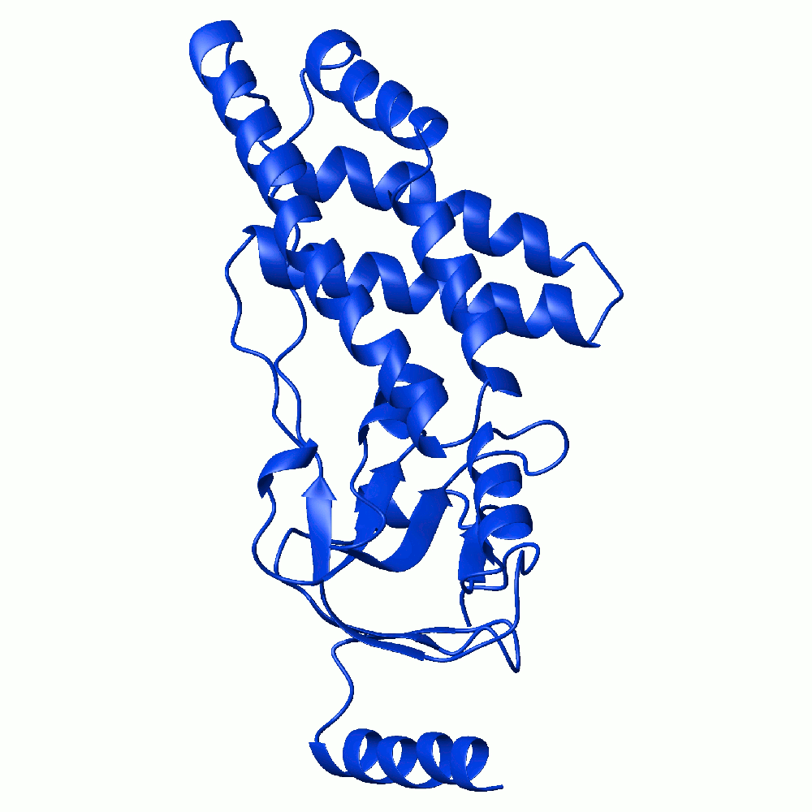
Experimental observables and protein motions
Overall Rotations

Slide 5
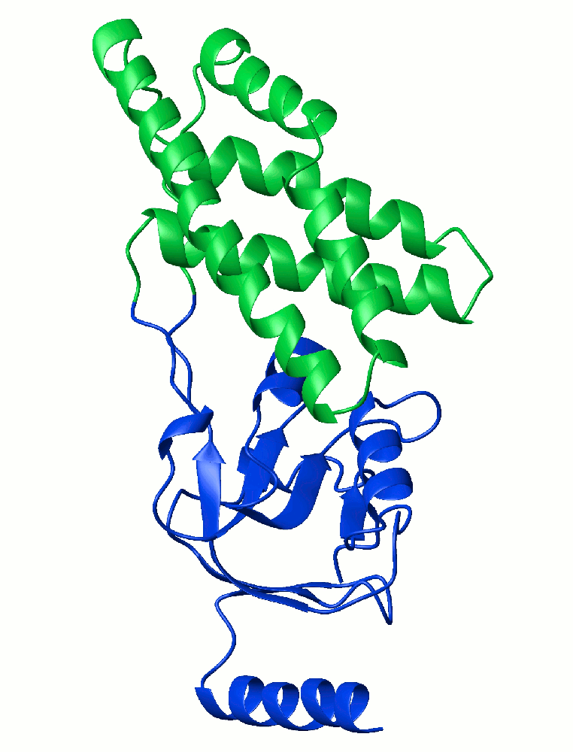
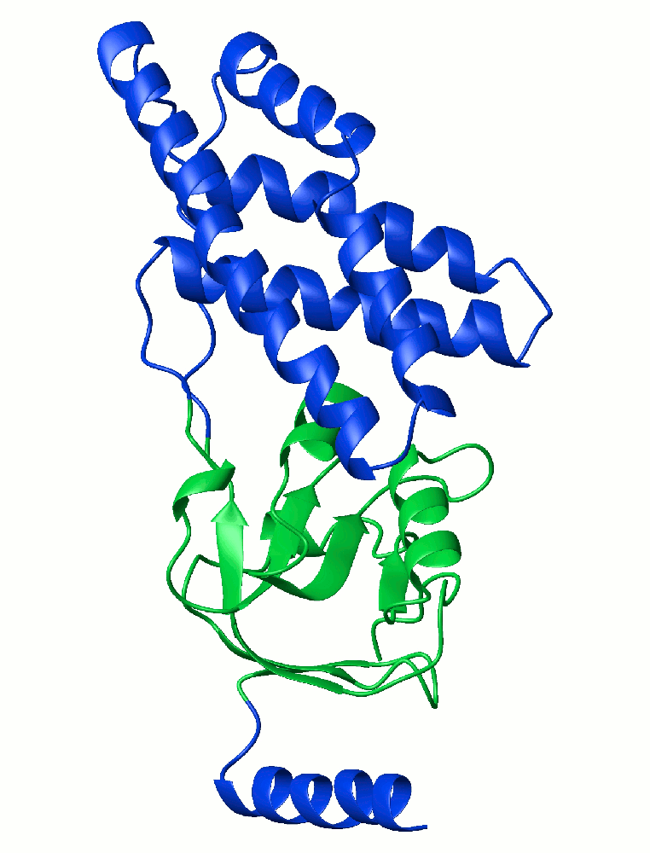
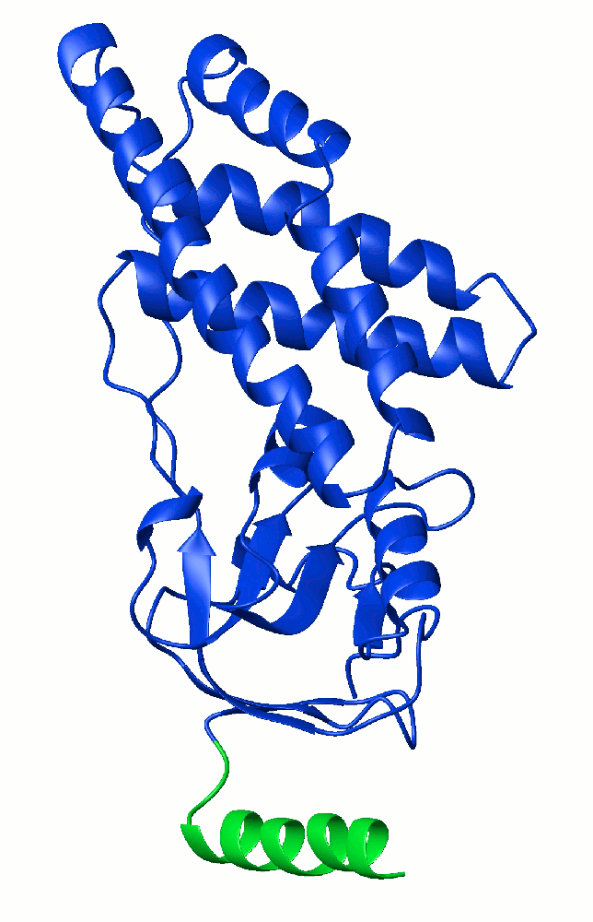
Experimental observables and protein motions
Domain Motions

Slide 6
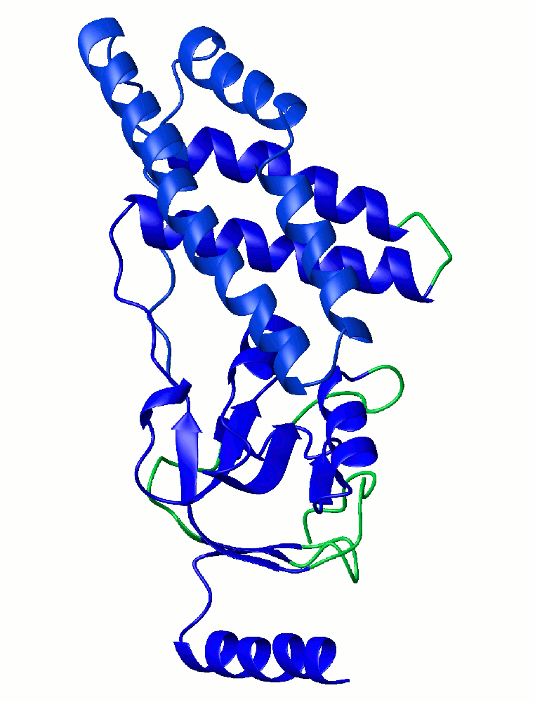
Experimental observables and protein motions
Local Motions

Slide 7
Dynamic information as structural restraints
Assumption: NO internal dynamics
Depend on Principal Values
of overall Diffusion Tensor
Dependency on residue specific Euler angles
Which define orientation of NH bond with respect to
Principal axis of Diffusion Tensor
Perrin F, 1934,1936; Favro DL, 1960; Woessner DE, 1962

Slide 8
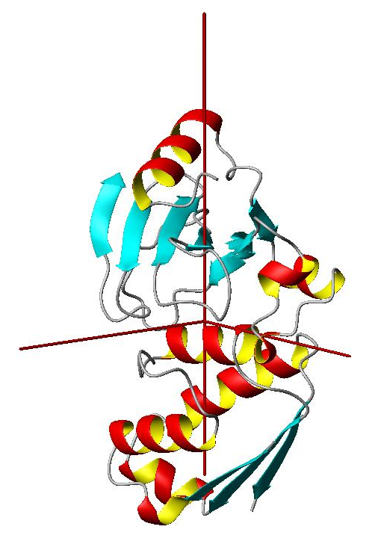
Overall shape restraints from Diffusion tensor
D_{z}
D_{x}
D_{y}
3 Euler angles for
Diffusion Tensor PAF

Slide 9
Diffusion Properties of Proteins from ellipsoid model
Why an ellipsoid model ?
Diffusion Tensor
Ellipsoid Shell
A_{z}
One-to-One
mapping
A_{x}
A_{y}
3 Euler angles for
Diffusion Tensor PAF
3 Euler angles for
Ellipsoid orientation

Slide 10
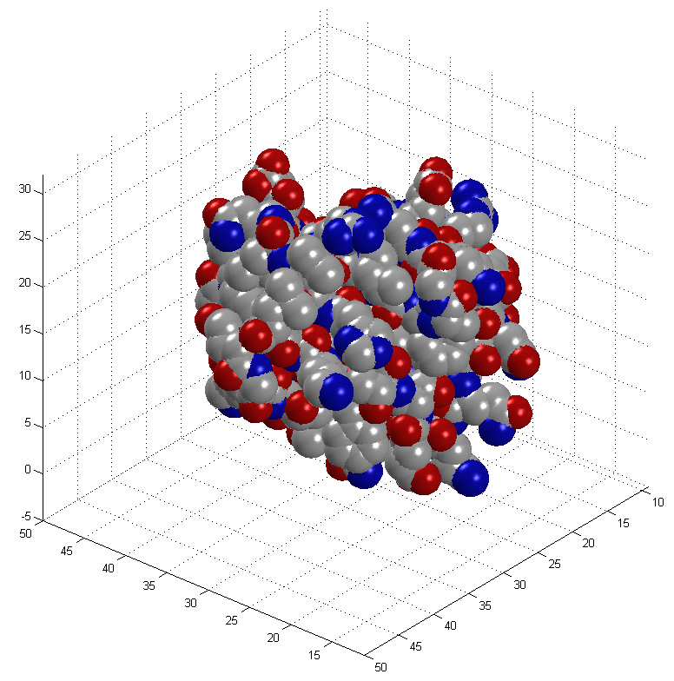
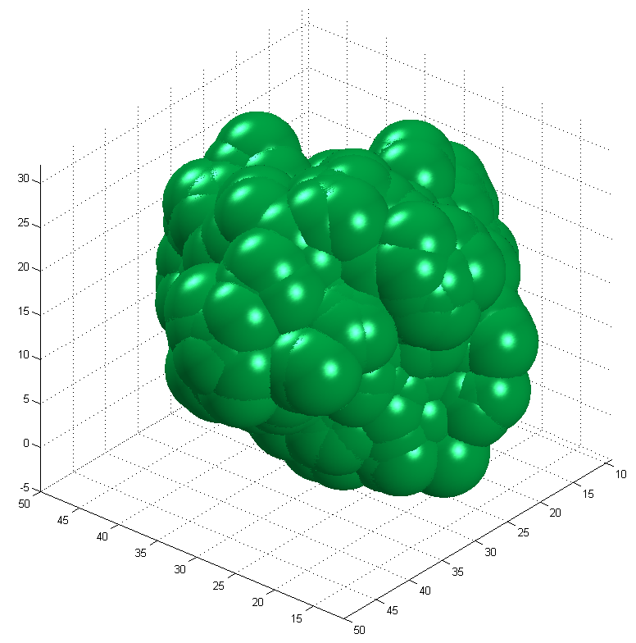
Hydration shell
“Dry”
Hydrated

Slide 11
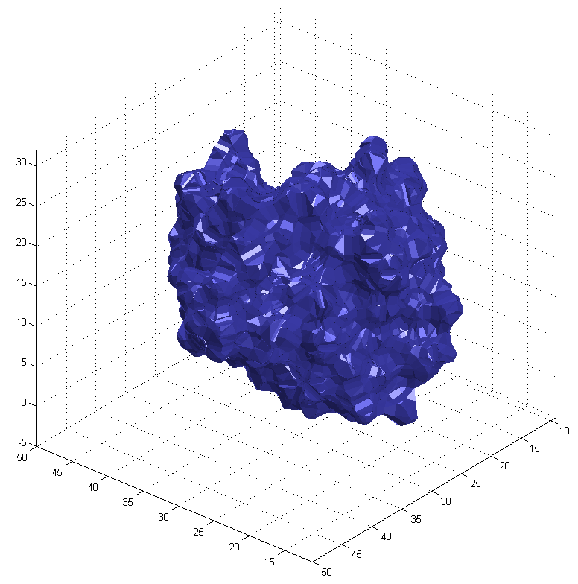
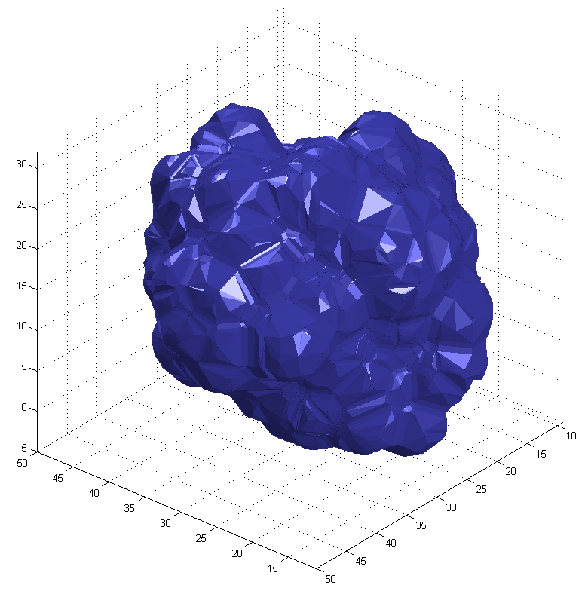
Hydration shell
“Dry”
Hydrated

Slide 12
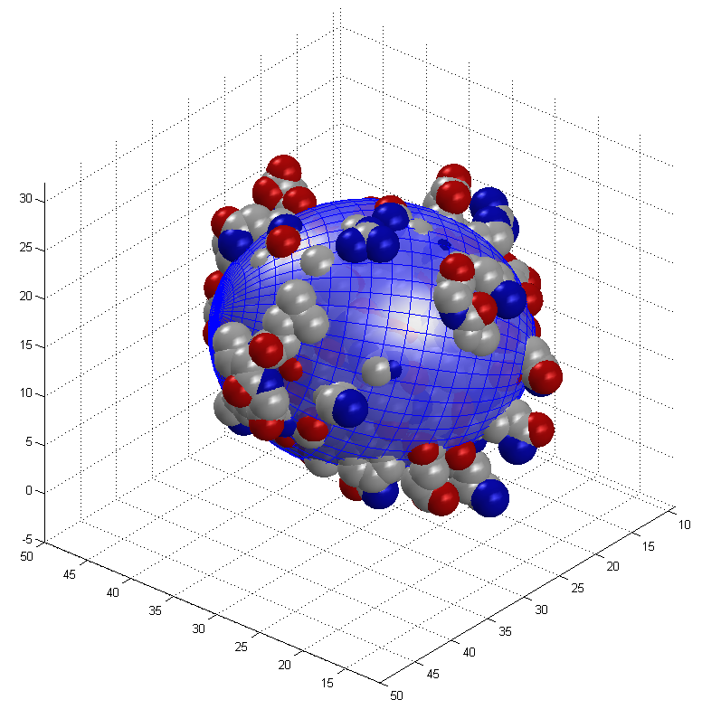
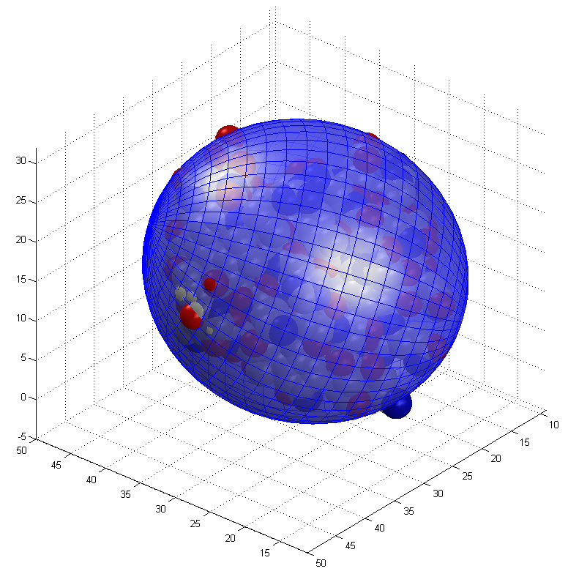
Hydration shell
Equivalent ellipsoid is approximately twice bigger
“Dry”
Hydrated

Slide 13
A Very General Concept: using components of diffusion tensor
overall shape restraints from NMR relaxation data
During the course of structure elucidation build an equivalent ellipsoid for every snapshot of protein structure conformation
Then calculate parameters of protein diffusion tensor using the equivalent ellipsoid shape
Compare calculated diffusion tensor parameters with those which were derived from the experimental data and establish a pseudo energy term proportional to the sum of square differences between components of calculated and experimental diffusion tensors

Slide 14
Assembling structures of multi domain proteins
using the overall shape restraints provided by the diffusion tensor
Global restraints on Overall shape

Slide 15
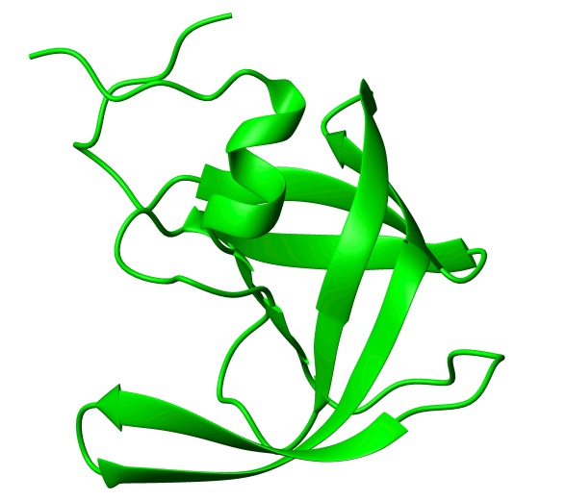
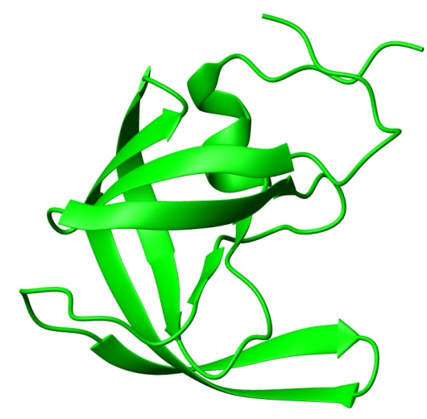
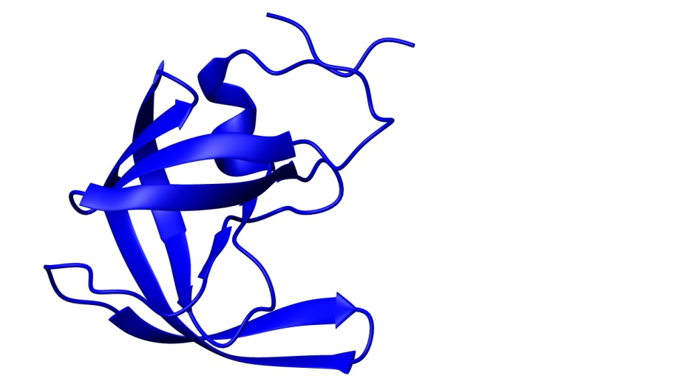
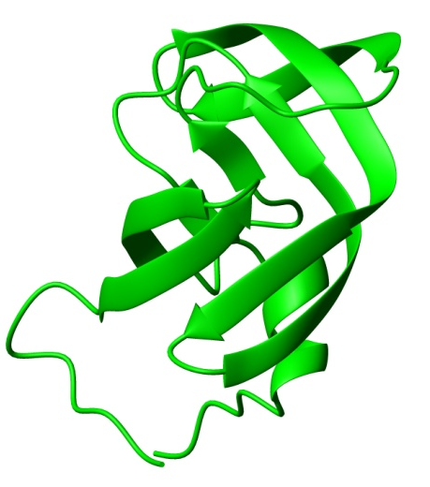
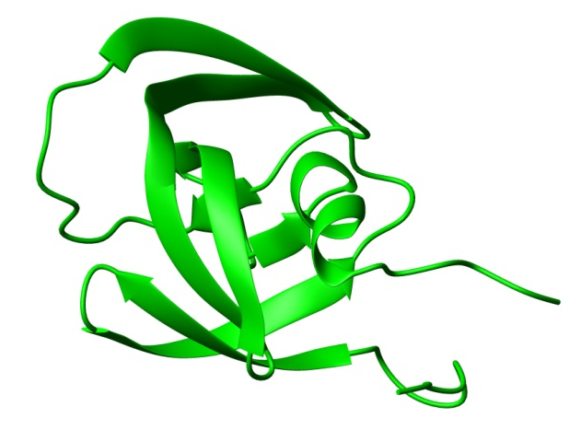
Assembling structure of a symmetric protein homo dimer
HIV -1 protease

Slide 16
Assembling structure of a symmetric protein homo dimer
Generic docking protocol
Part I:
Rigid body dynamics
for raw domain positioning.
Part II:
Simulated annealing
with flexible side chains
for final adjustment.

Slide 17
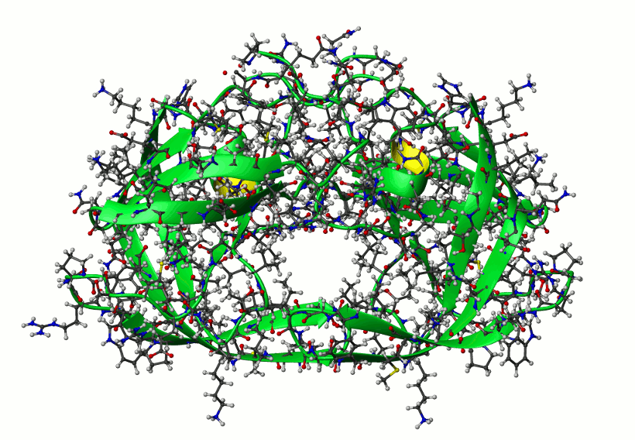
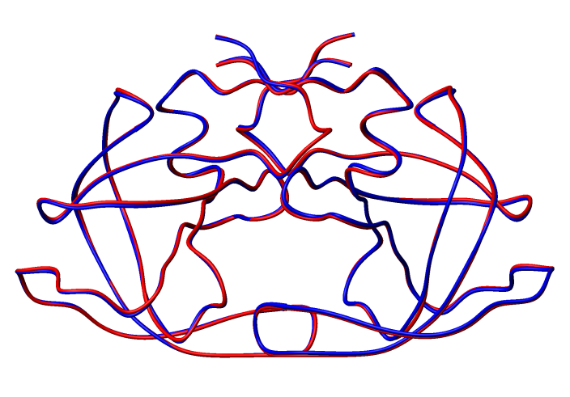
Assembling structure of a symmetric protein homo dimer
HIV -1 protease
Shape restraints from
Components of diffusion tensor
10 lowest energy structures
Averaged over 10 lowest energy structures (blue) versus reference (red)
Cα RMSD 0.35 ±0.09 [Å]

Slide 18
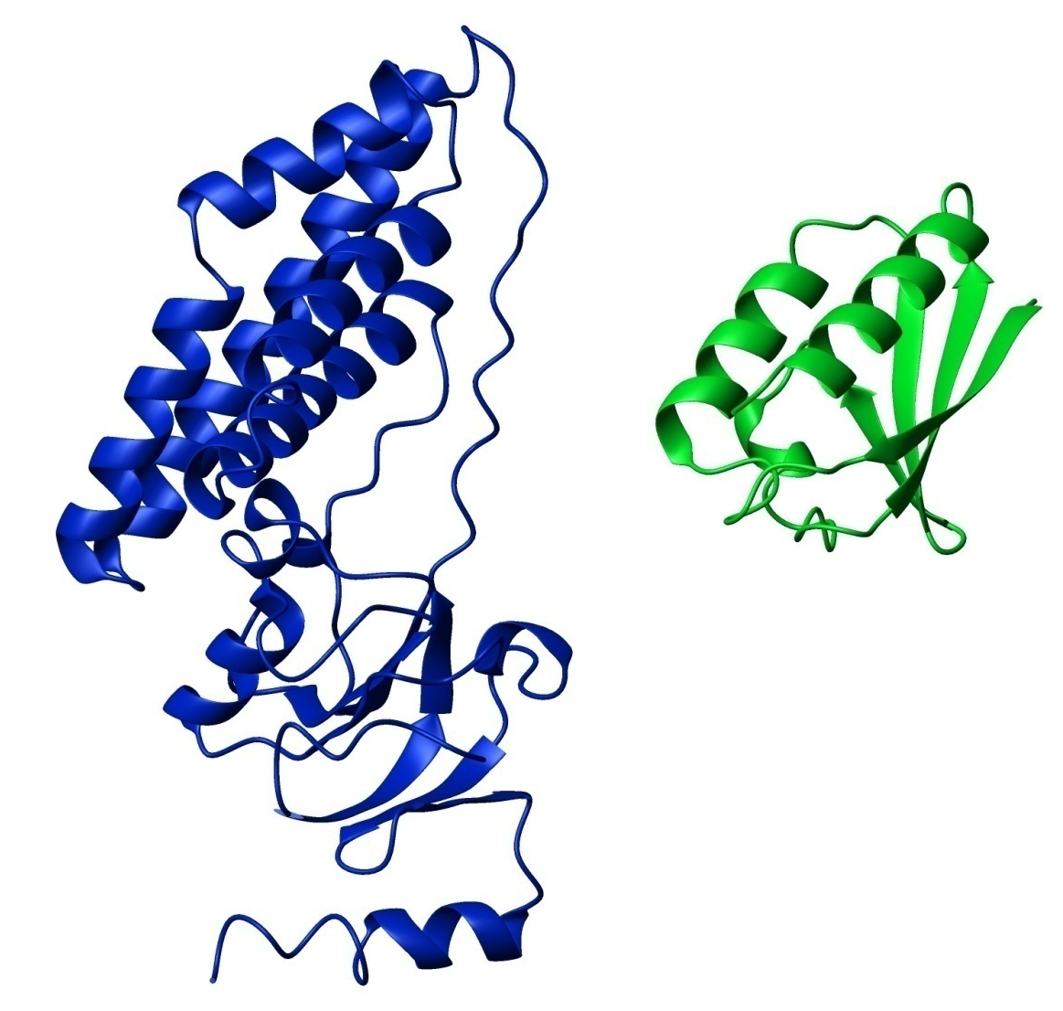
Application to an asymmetric complex
Shape restraints from
Components of diffusion tensor
EIN – HPr complex

Slide 19
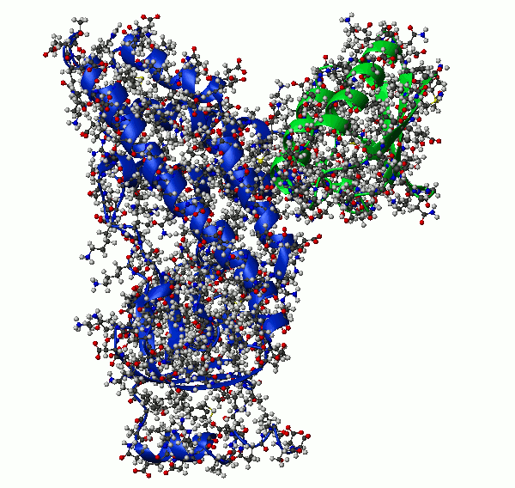
Application to an asymmetric complex
Shape restraints from
Components of diffusion tensor
EIN – HPr complex
10 lowest energy structures

Slide 20
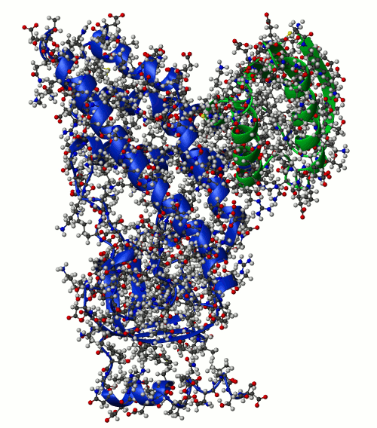
Application to an asymmetric complex
Shape restraints from
Components of diffusion tensor
EIN – HPr complex
10 lowest energy structures

Slide 21
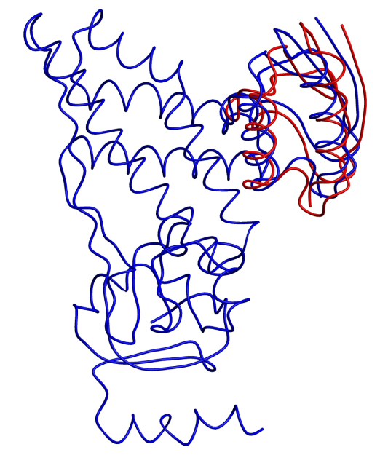
Application to an asymmetric complex
Shape restraints from
Components of diffusion tensor
EIN – HPr complex
10 lowest energy structures
Cα RMSD 1.20 ±0.03 [Å]

Slide 22
Using both shape and orientation restraints
ratio of relaxation rates
Overall Shape
Bond Orientation
Ratio of relaxation rates “almost” independent of local motions
Tjandra N and Bax A, 1995

Slide 23
Using both shape and orientation restraints
ratio of relaxation rates
Overall Shape
Bond Orientation
Energy of a potential term

Slide 24
Using both shape and orientation restraints
R₂/R₁ ratio of relaxation rates
10 lowest energy structures
from the red cluster
Cα RMSD 0.30 ±0.06 [Å]

Slide 25
Using both shape and orientation restraints
R₂/R₁ ratio of relaxation rates
Symmetry in orientation information
A
B
C

Slide 26
Using both shape and orientation restraints
R₂/R₁ ratio of relaxation rates
10 lowest energy structures
from the most populated cluster B
Cα RMSD 1.73 ±0.20 [Å]

Slide 27
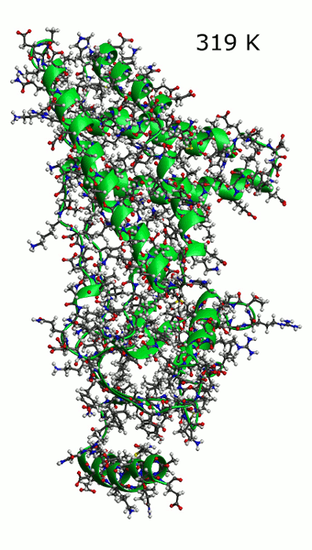
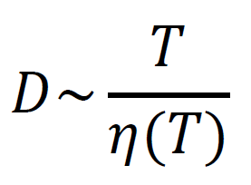
Uncertainties in experimental data
Scaling factor for the diffusion tensor
Sample Temperature
Viscosity
and uncertainties in
Thickness of hydration layer
Could be compensated by adjustment of setup for
Apparent “experimental ” temperature

Slide 28
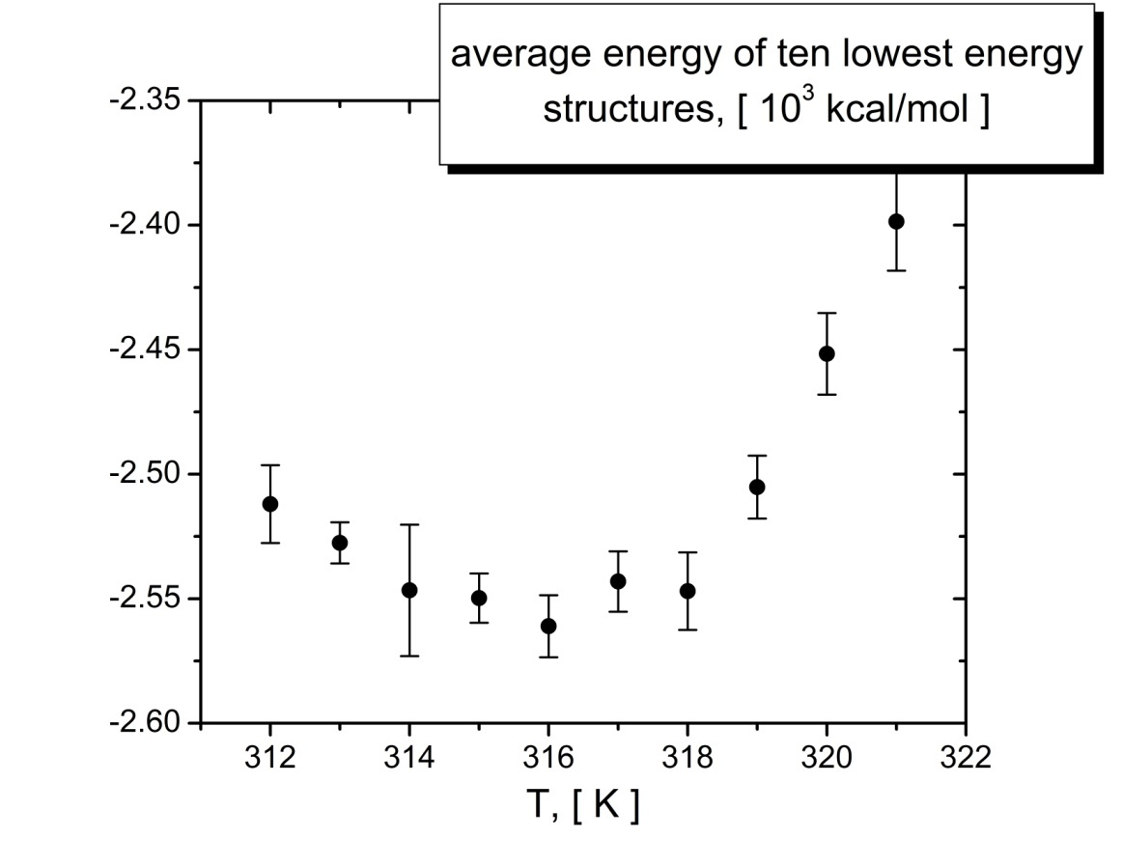
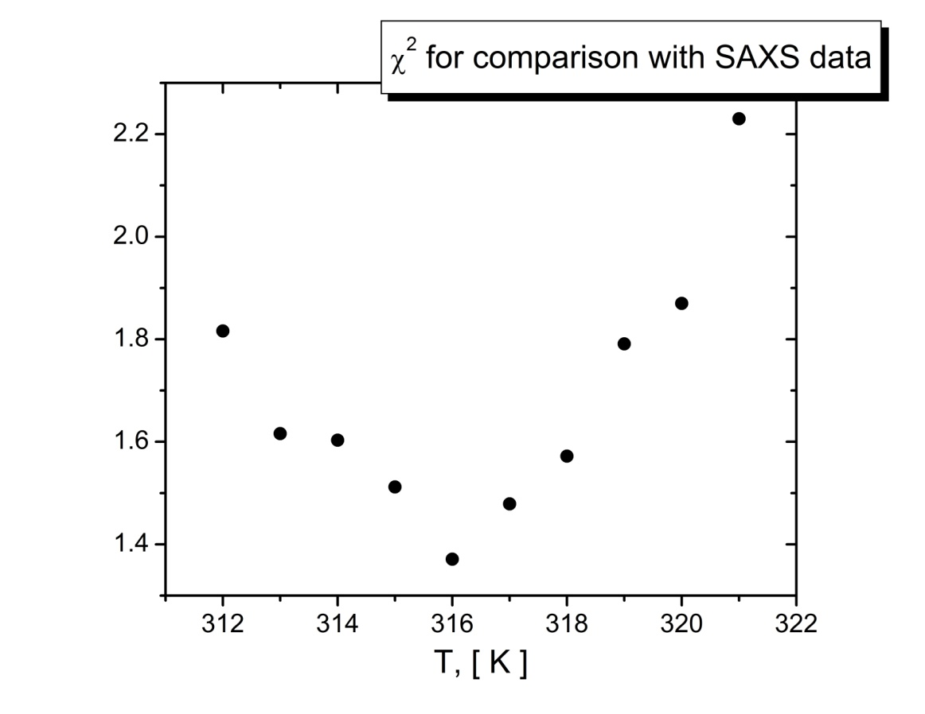
Effect of temperature settings
Example of EIN
Nominal temperature: 313 K
Temperature of the minimum: 316 K
Uncertainties in
thickness of hydration layer, sample temperature, and sample viscosity

Slide 29
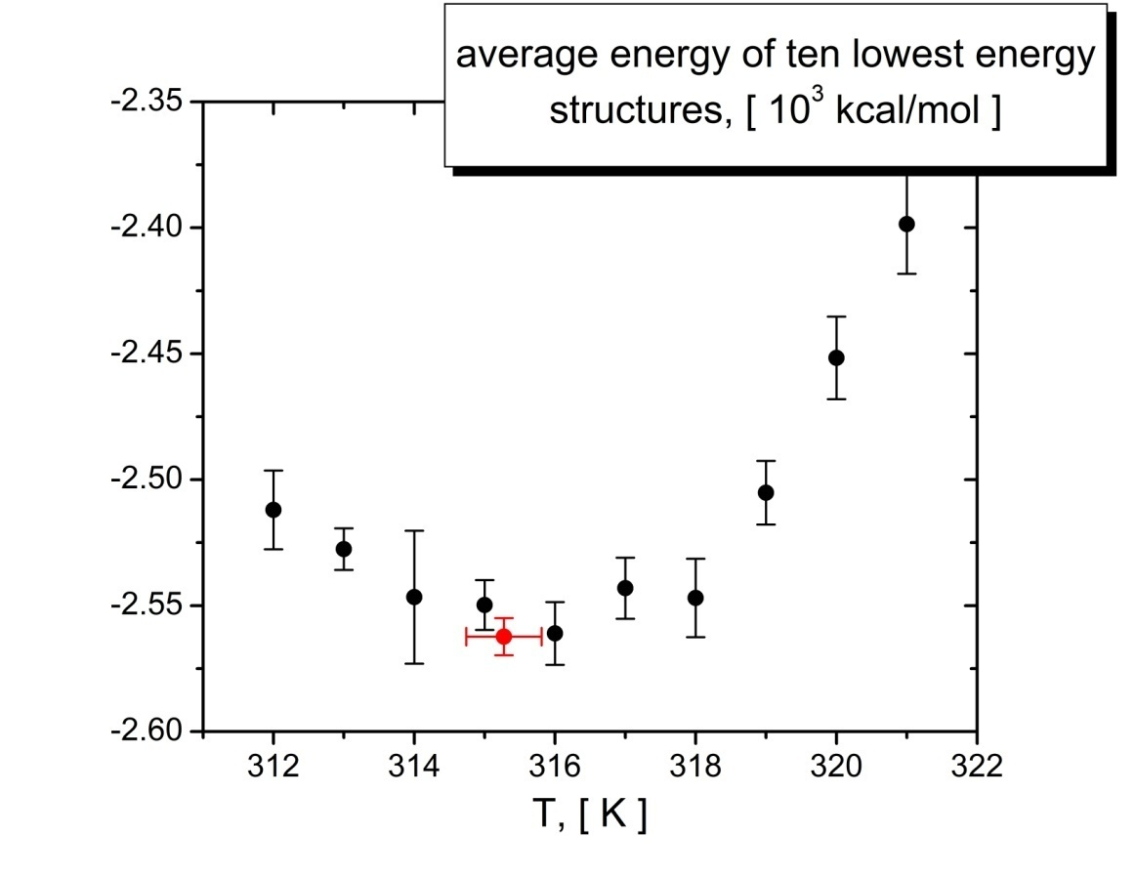
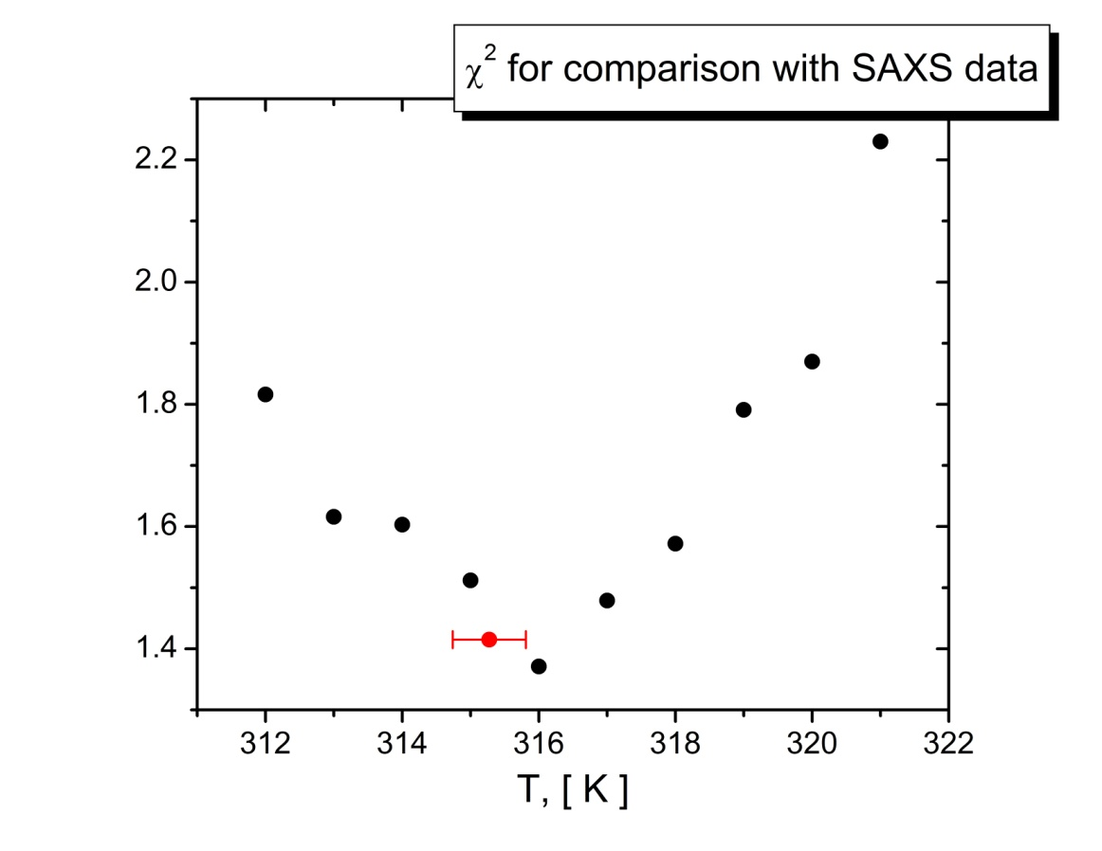
Effect of temperature settings
Example of EIN
Nominal temperature: 313 K Optimized Temperature: 315.3 ± 0.5
Temperature of the minimum: 316 K
Uncertainties in
thickness of hydration layer, sample temperature, and sample viscosity

Slide 30
“Errors” in experimental data
Possible reasons for errors in experimental data
Internal motions
Errors in domain structure (for docking)
Systematic and random errors in data acquisition

Slide 31
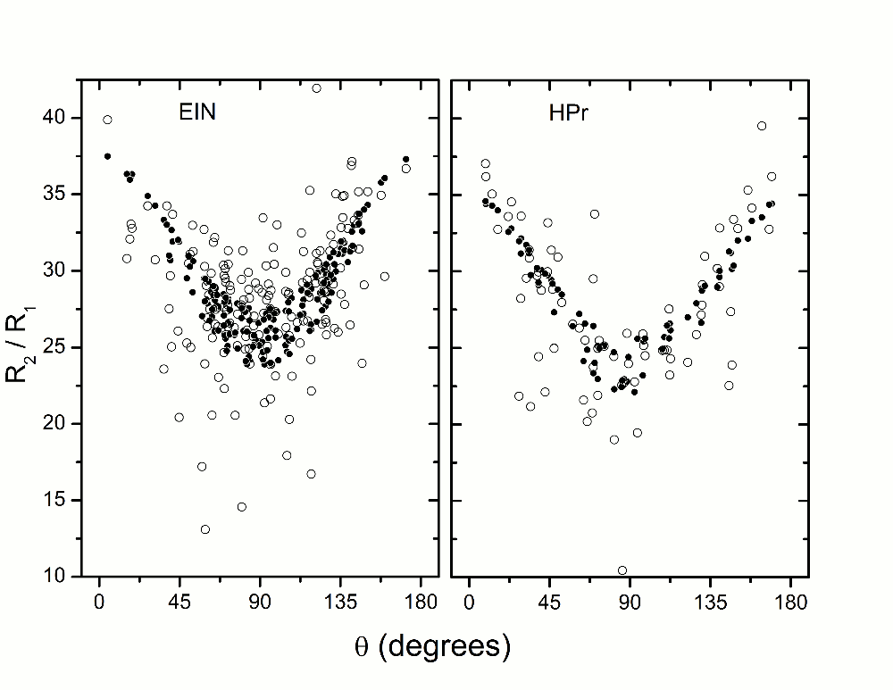
“Errors” in experimental data

Slide 32
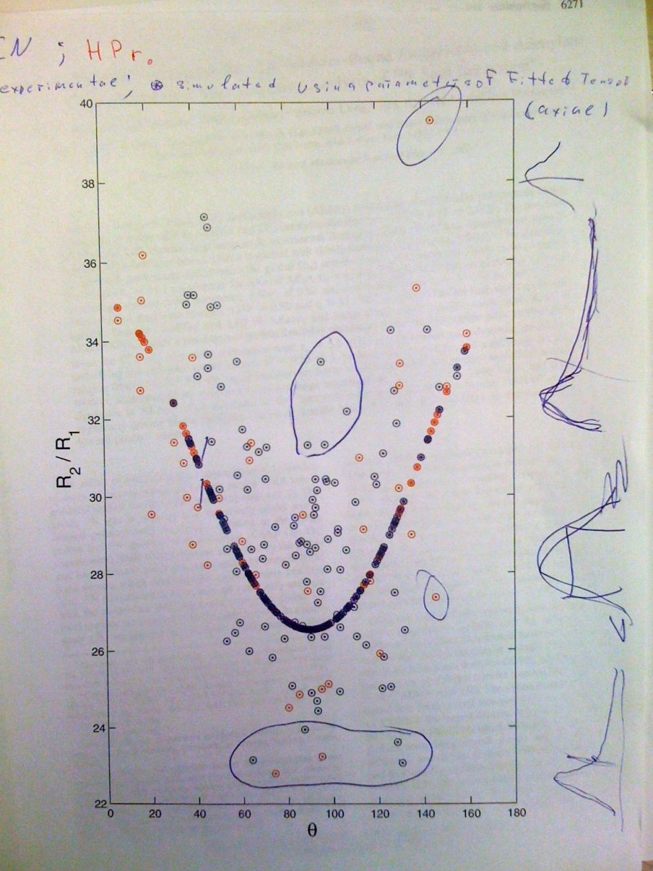
“Errors” in experimental data

Slide 33
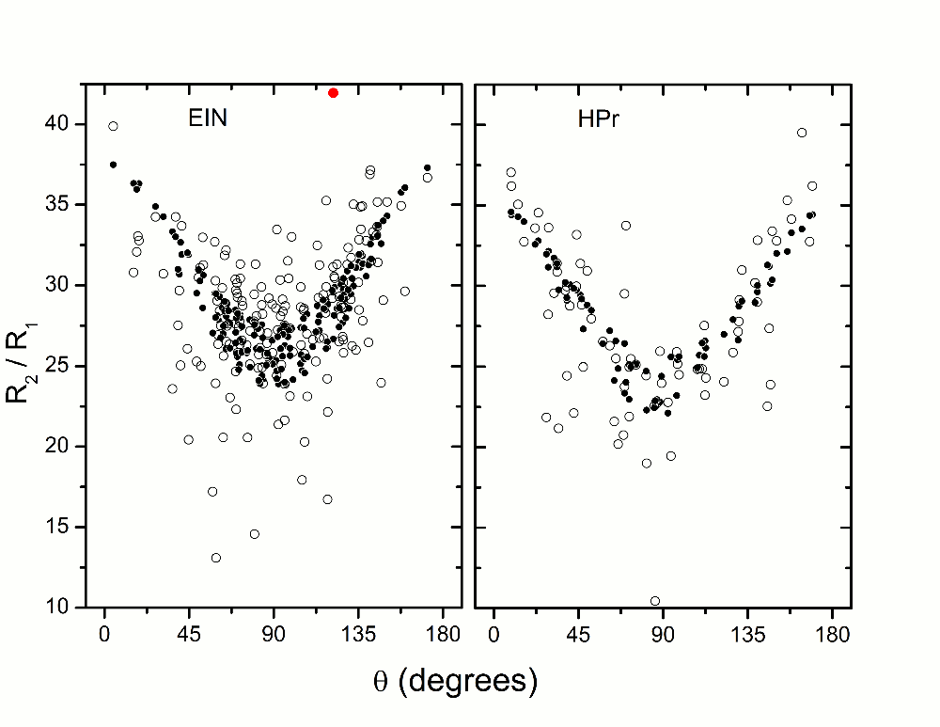
“Errors” in experimental data
Iterative pre-filtering procedure
Rule out the data point with the largest absolute deviation

Slide 34
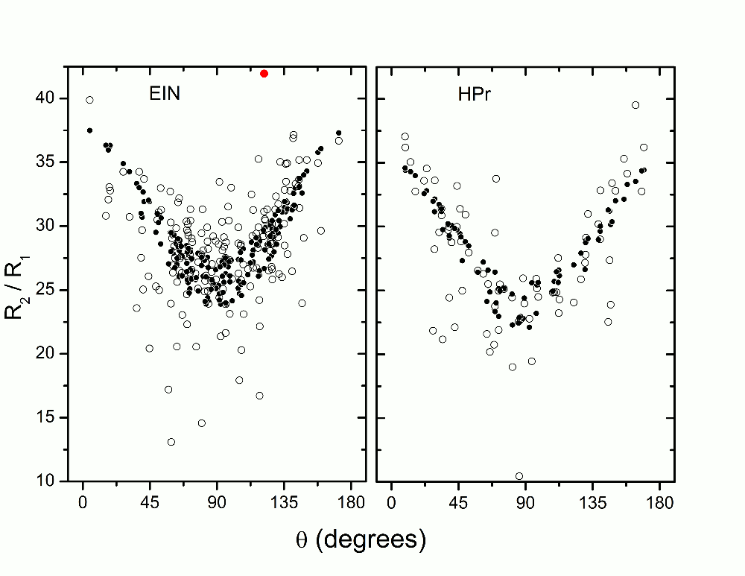
“Errors” in experimental data
Iterative pre-filtering procedure
Rule out the data point with the largest absolute deviation
iteratively

Slide 35
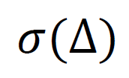
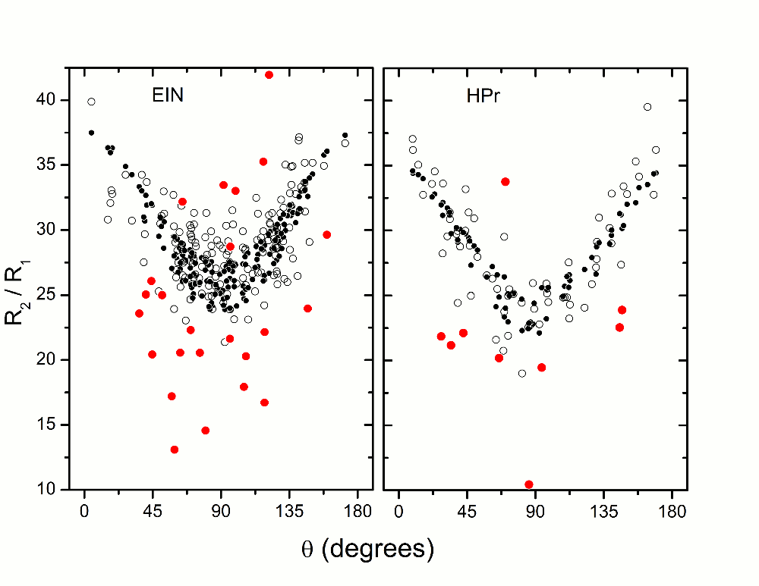
“Errors” in experimental data
Iterative pre-filtering procedure
standard deviation
Threshold ~ 13% of the whole data set

Slide 36
“Errors” in experimental data
Iterative pre-filtering procedure
Generates constant list of outliers
Acceptable for docking applications when initial domain structures are known
But
Unacceptable for structure determination

Slide 37
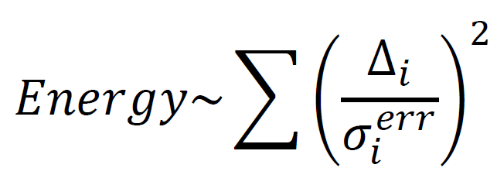
“Errors” in experimental data

Slide 38
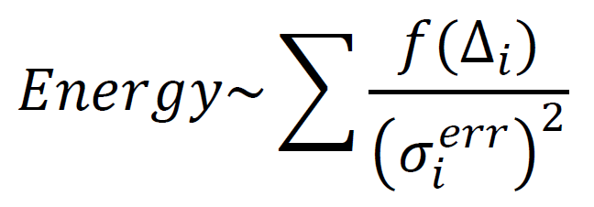
“Errors” in experimental data Adaptive Filtering
standard deviation
mean for the set of

Slide 39
Structure determination of globular proteins
Gb 3: b.b.Cα RMSD 3.2 [Å]
Ubiquitin: b.b.Cα RMSD 3.5 [Å]
Experimental restraints:
Dihedral angles from TALOS+ predictions
Back Bone Hydrogen bonds connectivity

Slide 40
Structure determination of globular proteins
Gb 3: b.b.Cα RMSD 1.1 [Å]
Ubiquitin: b.b.Cα RMSD 1.8 [Å]
Experimental restraints:
Dihedral angles from TALOS+ predictions
Back Bone Hydrogen bonds connectivity
R₂/R₁ ratios of ¹⁵N relaxation rates
+

Slide 41
Structure determination of globular proteins
EIN: b.b.Cα RMSD 14.7 [Å]
Experimental restraints:
Dihedral angles from TALOS+ predictions
Back Bone Hydrogen bonds connectivity
and
limited set of 804 NOEs
for methyl and HN protons

Slide 42
Structure determination of globular proteins
EIN: b.b.Cα RMSD 4.1 [Å]
Experimental restraints:
Dihedral angles from TALOS+ predictions
Back Bone Hydrogen bonds connectivity
and
limited set of 804 NOEs
for methyl and HN protons
+
R₂/R₁ ratios of ¹⁵N relaxation rates

Slide 43
Future challenges
Computational / Theoretical
Inhomogeneous hydration layer
Treatment of internal motions
Better models for diffusion tensor predictions

Slide 44
Future challenges
Experimental / Spectroscopic
Temperature control and calibration
Viscosity measurements
Better spectroscopic techniques

Slide 45
Xplor-NIH facilities
Potential Terms
DiffPot restrains shape of a protein or a complex
input: components of diffusion tensor
features: temperature optimization
RelaxRatioPot restrains overall shape and individual bond ordinations
input: NMR relaxation data
features: temperature optimization
adaptive filtering
multiple fields
site specific CSA (optional)
switching off/on gradients
on shape/NH orientations (optional)

Slide 46
Xplor-NIH facilities
Service functions
Calculation of diffusion tensor for given structure
build into DiffPot and RelaxRatioPot
Relaxation Data Processing
fitRelaxData Fitting data to structure:
different fitting models
estimation of errors
in fitting parameters (optional)
filter_data Iterative data filtering
multi-domain systems
multiple fields

Slide 47
Xplor-NIH facilities
Examples and Helps
in every Xplor-NIH installation
~/xplor/eginput/
Example scripts for using DiffPot and RelaxaRatioPot
Sample scripts for
Docking
Refinement
Structure determination
with all necessary sample data files
Helper scripts for data fitting and filtering

Slide 48
Relevant publications
Y. Ryabov, G. M. Clore, C. D. Schwieters JACS, v. 133(16) (2011) pp. 6154–6157
Y. Ryabov, G. M. Clore, C. D. Schwieters JACS, v. 132(17) (2010) pp. 5987–5989.
Y. Ryabov, J.-Y. Suh, A. Grishaev, G. M. Clore, C. D. Schwieters JACS, v. 131(27) (2009) pp. 9522–9531.
Y. Ryabov, D. Fushman JACS, v. 129(25) (2007) pp. 7894-7902.
Y. Ryabov, C. Geraghty, A. Varshney, and D. Fushman JACS, v. 128(48), (2006) pp. 15432-15444.

Slide 49
ACKNOWLEDGMENTS
G Marius Clore
Charles Geraghty
Alexander Grishaev
David Fushman
Charles D Schwieters
Jeong-Yong Suh
Amitabh Varshney

